Slide 1
Participant Information
2024

Slide 2
Notes:
We have put together a short video that provides you with an understanding of what happens on an Operation Flinders exercise. This video includes first-hand perspectives from Operation Flinders Team Leaders as well as past participants just like you!

Slide 3
What is Operation Flinders?
Operation Flinders is an 8-day adventure program (referred to as an Exercise) in the far-north Flinders Ranges.
You and 9 other young people will form a team with the help of 4 adults - 2 Support Staff from your school/agency and 2 Team Leaders from Operation Flinders.
Over the 8 days your team will walk up to 100 kilometres, spend an evening with Adnyamathanhna Elders learning about local Indigenous culture, learn to navigate, cook over a fire, go abseiling or experience our high ropes course, sleep under the stars, develop camping and bush skills and most importantly, hopefully have a memorable experience in the Outback.
After the trip, you’ll have the opportunity to join our Next Step program and experience a whole range of awesome activities like mountain biking and kayaking, as well as continuing your learning, leadership, and wellbeing journey.

Slide 4
What is Operation Flinders isn’t…
Operation Flinders is not:
A Boot Camp
Punishment
Only for the ‘naughty’ kids
Designed to ‘teach you a lesson’
About making you endure pain and suffering
A ‘march through the bush’
Like the TV show Survivor
Notes:
Consider adding – training – development - wellbeing

Slide 5
Where is Operation Flinders?
The Operation Flinders Exercise takes place on Yankaninna Station on Adnyamathanha Country, 600km north of Adelaide is in the northern Flinders Ranges, east of Copley & Leigh Creek.
Operation Flinders Foundation acknowledges that the Adnyamathanha people are the traditional custodians of the Country on which exercises take place - Yankaninna Station.
Operation Flinders recognises that ‘Country’ incorporates the land, water, and sky. It is also the blood, spirit, creation stories, teachings, and lore of Aboriginal people. We pay our respect to this connection, as well as to the Elders, past and present.

Slide 6
Why Should I Do Operation Flinders?
A space where you will be respected, valued and supported.
An invitation to step out of your comfort zone, learn more about yourself and what you’re capable of.
A chance to accomplish something significant and achieve things that maybe you thought you never would or could do.
An opportunity to be adventurous, challenge yourself, undertake different experiences and develop skills to prepare yourself for the future
Notes:
courage

Slide 7
Who Will Be Leading Me?
You’ll be led by two Operation Flinders Team Leaders for the entire duration of the exercise. They’ll be supported by two Staff from your school/agency.
They all undertake training and must prove that they can undertake their role of keeping you safe throughout the program.
Team Leaders volunteer their time and skills to lead you on an adventure across Yankaninna Station for 8 days.
Team Leaders come from many diverse backgrounds, each has a unique story to tell and are aged anywhere between 21 and 60-ish years old with some volunteering with Operation Flinders for over 25+ exercises.

Slide 8
When Is It?
There are 5 exercises held each year.
Your school or agency coordinator will inform you of the dates of the exercise that you’ll be attending.
Exercise 1 | Monday May 13 - Friday May 24
Exercise 2 | Monday June 17 - Friday June 28
Exercise 3 | Monday August 5 - Friday August 16
Exercise 4 | Monday September 9 - Friday September 20
Exercise 5 | Monday October 21 - Friday November 1

Slide 9
A Typical Day on an Operation Flinders Exercise
Morning | As the sun rises over the mountains, you and your team will prepare for the day’s adventure. You will pack up your gear and double-check that you have everything you need for the journey ahead - sturdy boots, warm clothes, a sleeping bag, and plenty of water. After a hearty breakfast, there are team jobs to do including cleaning and packing up camp, ensuring lunch are snacks are distributed for the day and that everyone has all the water and equipment they need. With your bodies warmed up and your minds prepared, you will set out on the trail for a day of hiking through stunning natural landscapes.
During the Day | As you traverse some challenging rocky terrain, dry creek beds, and mountain tops, you will stop to catch your breath and take in the breathtaking views around you. You might do some team-building activities and games. At some point, you will have the opportunity to take part in additional activities such as abseiling or high ropes and learn bushcraft and navigation skills.

Slide 10
A Typical Day on an Operation Flinders Exercise
Afternoon | When you reach your next campsite, you will set up your sleeping spot and enjoy a bit of well-earned downtime to relax and recharge. Before kicking on with dinner, jobs including establishing the bush toilet, collecting firewood and organising the communal camp area will need to be completed.
Evenings | Dinner will be a communal effort, with everyone pitching in to cook and clean up. As the evening wears on, you will enjoy the warmth of the fire and the serenity of the wilderness around you. After a tiring day, it will be time to head to your shelter and sleep among the sounds of nature. As the sun sets, you and your team will gather around a campfire, playing games and swapping stories about the day's adventures.

Slide 11
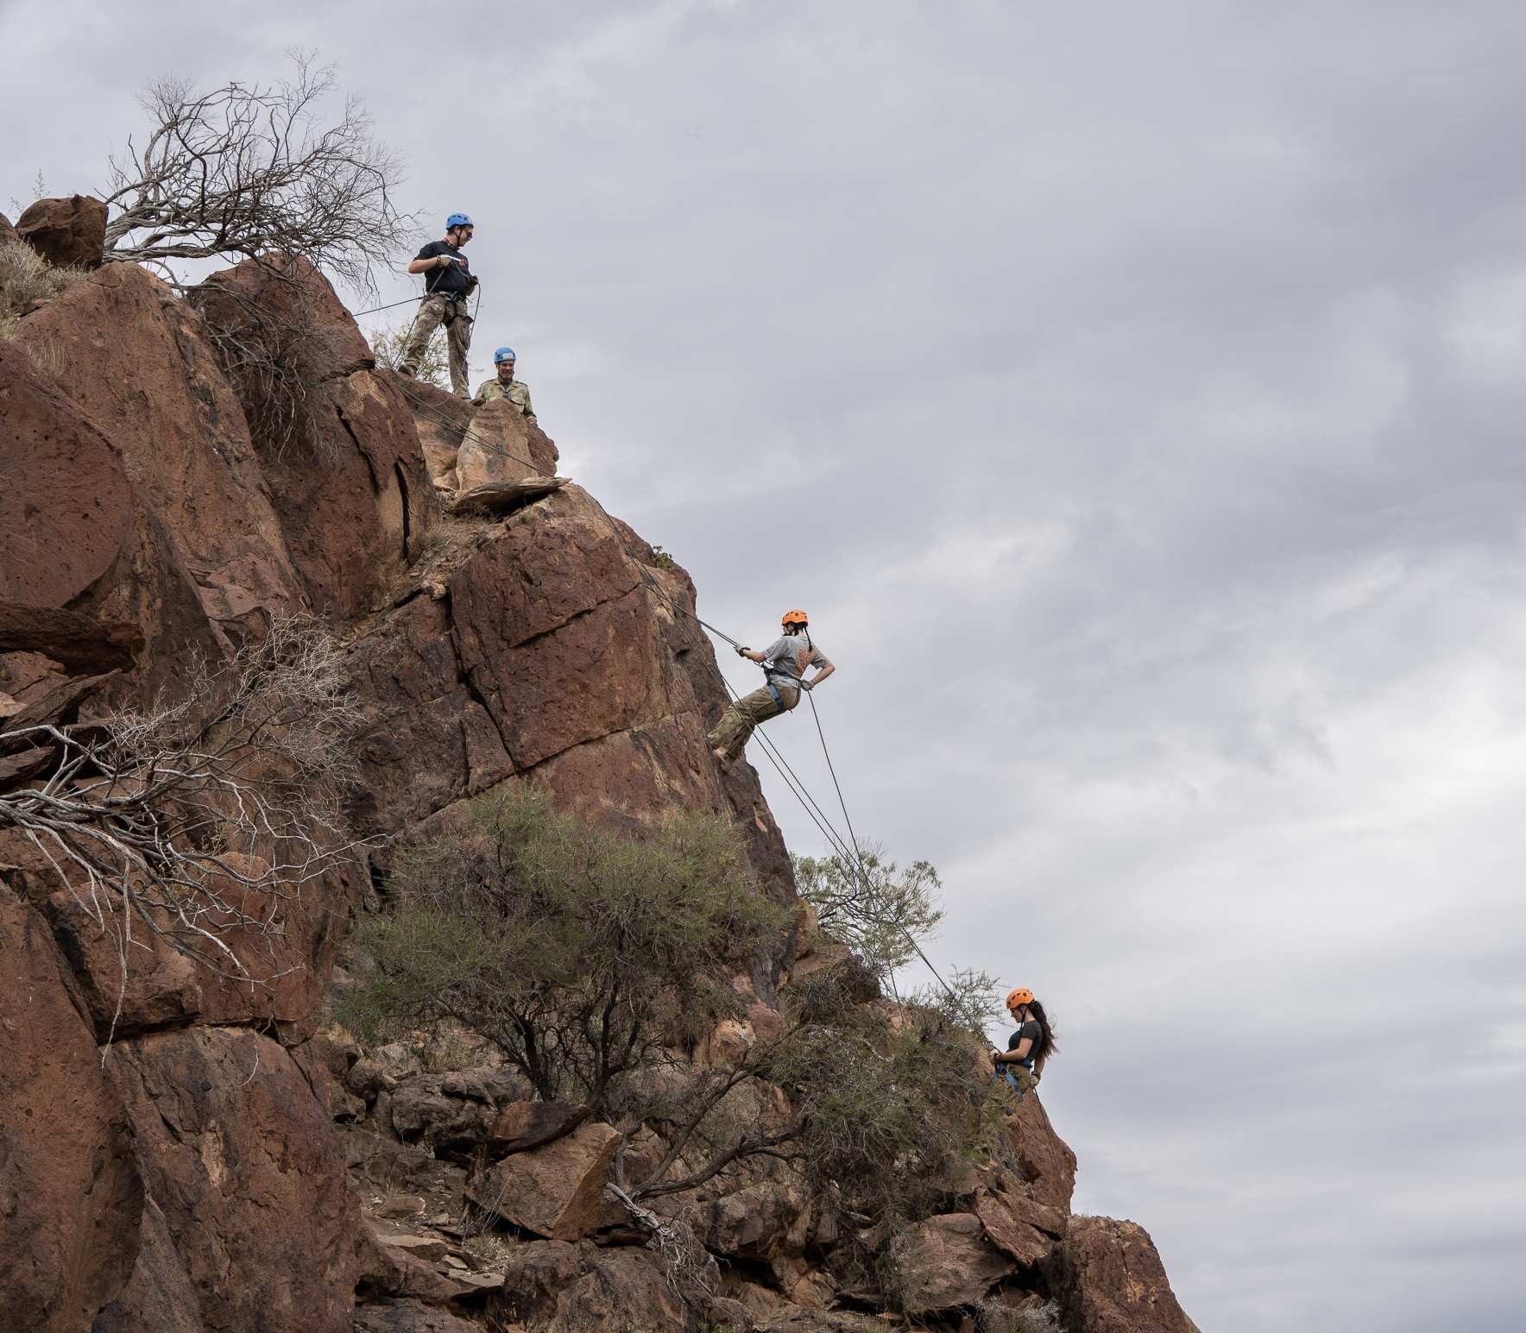
Adnyamathanha Connection
On one evening, you’ll have the opportunity to connect with, share a meal and learn from local First Nation Adnyamathanha people.
Abseil or High Ropes
During your exercise you’ll be invited to participate in abseiling or a high ropes course on Yankaninna Station. This is facilitated by experienced instructors and we only use the highest quality equipment!

Slide 12
What to Bring?
On the next few slides is a packing list.
This will also be made available to you as a printed copy.
The Packing List is provided to ensure you have the right equipment for this experience.
The items in green are not critical but are suggested options for you to consider.
In the first instance, if there are any issues or concerns in obtaining items from this packing list, please speak with your school/agency coordinator who can look to assist.

Slide 13
Equipment You Get to Keep!
Upon arrival, you’ll be provided with a brand-new:
Sleeping Bag
Hat
Buff Scarf
These are for you to use throughout the exercise and then keep and take home with you at the end.
You’ll need Hiking Boots!
Having comfortable and sturdy footwear is important to make the most out of this experience and reduce any possible pain and blisters.
Ensure you get onto sorting out a pair of hiking boots as soon as possible so you can wear them in and become comfortable with them!

Slide 14
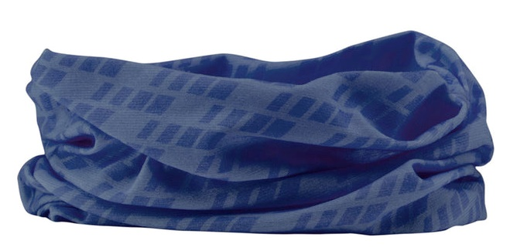
Operation Flinders will provide you with…
Hiking Backpack | Hutchies (Small Shelters) | Sleeping Bags (New & yours to keep after exercise)
2x 1L Water Bottles | Rain Jacket | Sleeping Mat
Eating/Drinking Cup | Spoon
Wide Brimmed Hat (New & yours to keep after exercise) | Buff (New & yours to keep after exercise) | Sock protectors (gaiters)

Slide 15
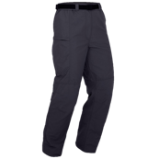
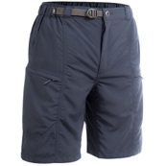
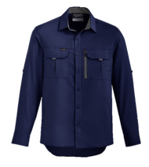
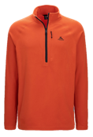
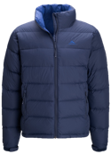
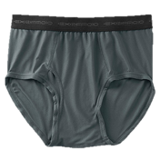
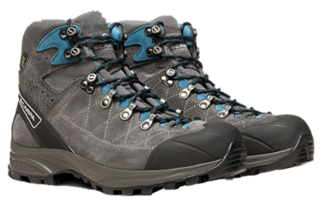
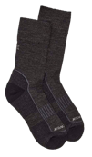
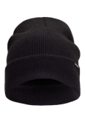
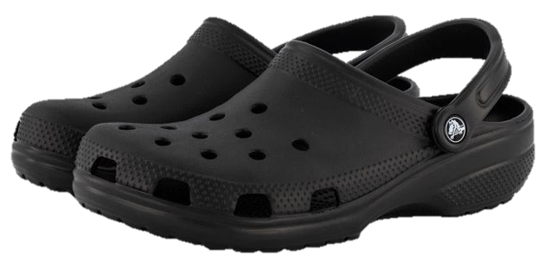
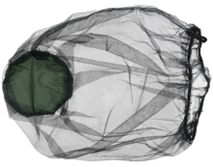
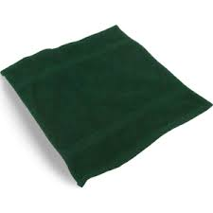
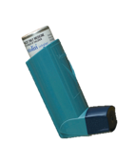
Packing List
BLUE – Operation Flinders Will Supply | GREEN – Optional Suggested Item
1 – 2 pairs of loose comfortable walking pants/ cargo pants - not jeans 1 pair of shorts (in warmer months) | 2 t-shirts/shirts- suitable for walking in the sun (should have collars and long sleeves) | 1 t-shirts/shirts- for wearing during downtime at camp | 1 warm jumper/jacket
Hiking Boots and shoes to wear at camp | 3 – 4 pairs of thick socks | 4 – 8 pairs of Undies - cotton, comfortable | 1 beanie for cold nights
Head Torch | Spare Batteries for Head Torch | Sunglasses | Hiking Poles
Toothbrush & Toothpaste | Sunscreen & Lip Balm | Wet Wipes (Biodegradable) & Hand Sanitiser | Insect Repellant & Head Net
Face Cloth | Chafing Cream & Sports Tape (for Blisters) | Personal Medication | Sanitary Items

Slide 16
Items to Leave at Home!
For your safety and to maximise your experience, the below items are not permitted.
Phones & Other Electronic Devices (no phone coverage and no charging facilities) | Cigarettes & Vapes (illegal and will be reported to local police) | Alcohol (illegal and will be reported to local police)
Knives, Sharps or any Other Weapons (illegal and will be reported to local police) | Non-Prescribed Drugs (illegal and will be reported to local police) | Energy Drinks

Slide 17
Further Information
Please discuss with your school or agency coordinator if you require more information about the experience.
Alternatively, you can learn more about Operation Flinders via our website - https://operationflinders.org.au/exercises/

